Slide 1
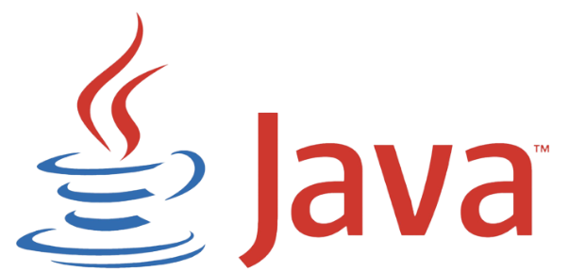
Grupo 04
Alberto Saboya – Anabella aceto – david rodríguez

Slide 2

Its origins...
It was launched in June 1991.
In 1996 Sun Microsystems the first public implementation of Java 1.0
In 1998, Java 2 was released and it added multiple configurations designed for different types of platforms.
In 2006 is launched as free and open-source software.
In 2009, Oracle Corporation acquared Sun Microsystems.

Slide 3
OJBECT ORIENTATION IN JAVA
Java is an object-oriented programming language.
Based on the concept of "objects" encapsulating data and behavior
Java is a widely used, object-oriented programming language
Key Aspects:
Everything in Java is considered an object
Objects are instances of classes, serving as blueprints
Classes define properties (attributes) and behaviors (methods)

Slide 4
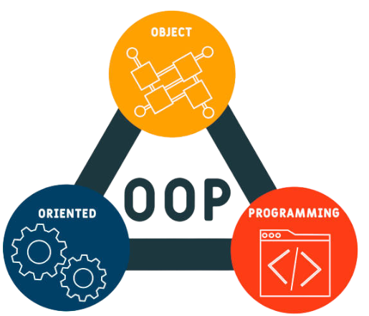
Principles of Object Orientation in Java
Encapsulation.
Inheritance.
Polymorphism.
Abstraction.
Association and Composition

Slide 5

Memory management and garbaje collection
Automatic Memory Management: Java uses a garbage collector to automatically manage memory.

Slide 6
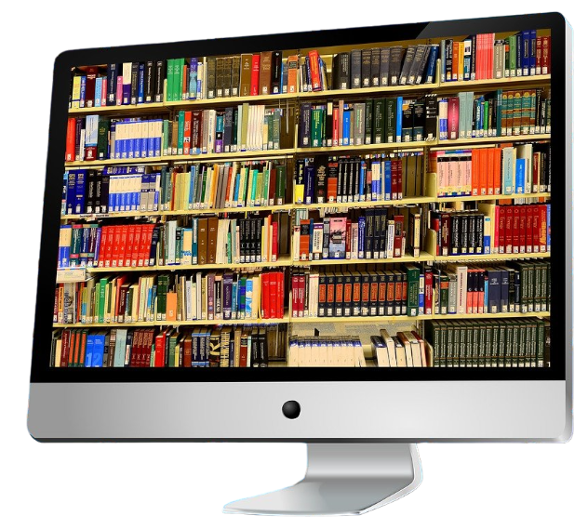
Extensive Standard Library
Java comes with an extensive standard library that provides classes and methods for various tasks, from string manipulation to network operations.

Slide 7
JAVA EE and se platform

Slide 8
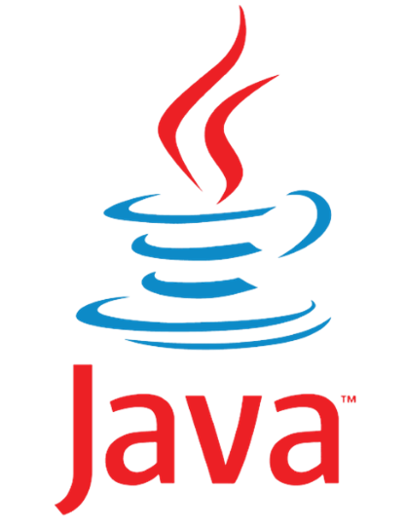
Java curiosities
Origin of the Name: Java got its name from coffee.
It was designed to programm smart TVs

Slide 9
Develop Java web apps
¿What are Frameworks?
The Frameworks are code libraries, they help to write more clean code and better structured code.
The most used Frameworks are:

Slide 10
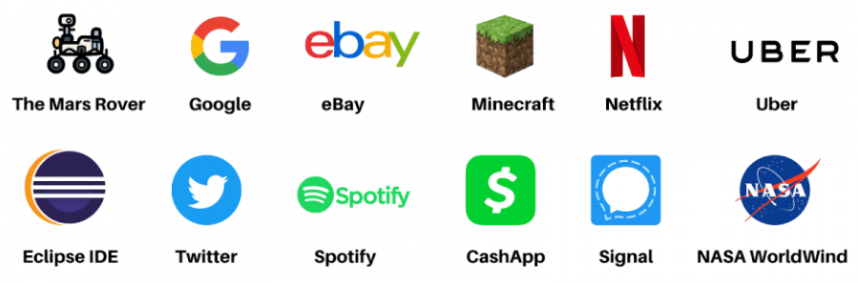
Develop applications more robust and scalable
Robust: Because Java memory management is very good, he know when to free memory and he do automatically, this makes Java very efficient.
Scalable: Java can control big aplications easily, is for it Java is used to big companies in her aplications

Slide 11
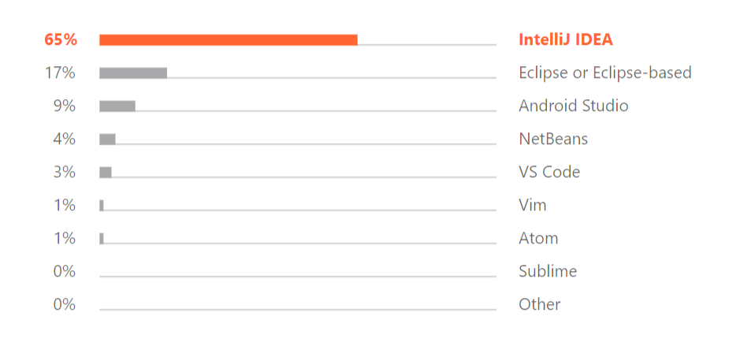



Tools and development environment
¿What is an IDE?
IDE significate is Integrated development environment, is a software use for devs for develop in different languages: Java – HTML – Python…
This tools help to write code more fast and detect errors in lines code, it also offers us suggestions on how to write our code to correct it.
Develop IDE most used

Slide 12
Java future and finaly conclusion
From my point of view, I think the future of Java will be very good and solid. For years, Java has proven to be a robust language, used in various applications. The continuous evolution of Java, with new versions and character updates, seeks a constant commitment to the demand for novelty and adaptability of software development.
Now, Java is still important for programming. People who use Java are active and helpful, supporting each other.
In short, looking at the past and what's happening now, Java could keep being a good choice for developers. It's good at adjusting to tech changes, and it's always getting better, so Java will likely stay important for making software.

